Slide 1

College Database Management System
Group members: 5
Name: Reuben, Simran, Bruno, Dylan, Beryl
Roll No: 14; 17; 10; 9; 4

Slide 2

Introduction
Data plays important role in every organization. Therefore storing that data, retrieving that data and presenting this data in uncomplicated fashion is essential.
Therefore we have built a database management system for college organization. In this three types of users can use this system; first college administrator second faculty and third type of users are students.
In this system the user can not only track their work/activity but also do the necessary changes as per the authority permitted.
As in college organization all this three users perform different operations, we have created different frames/canvas wherein on entering their appropriate data as in their login Id and password to make sure an authorized user has access to the system, they will be directed to their desired location/frame.
For every college administrator has a task to assign courses to the teachers and students. To accomplish this task, for the administrator we have created a canvas where the administrator can allocate courses and their ID to the teachers’ and students’.
Function of teacher is not only to teach students but also keep record of students like their address, their marks and other details. For teacher we have created a frame wherein by entering their Login ID and password they will be directed to the portal page where they can enter any students' marks obtained in various examinations and keep a track of the students’ progress.
Along with this teacher can also do modification as per the privileges granted to them.
For the third type of user i.e. the student must first register
After that they can keep track of the marks obtained in various courses. Their marks will be displayed in a graphical style.
Now all this data must be stored in a database system for which we have used MySQL Database.
For GUI we have used PyQt toolkit. Python packages like matplotlib and python graph are also used in a few places.

Slide 3
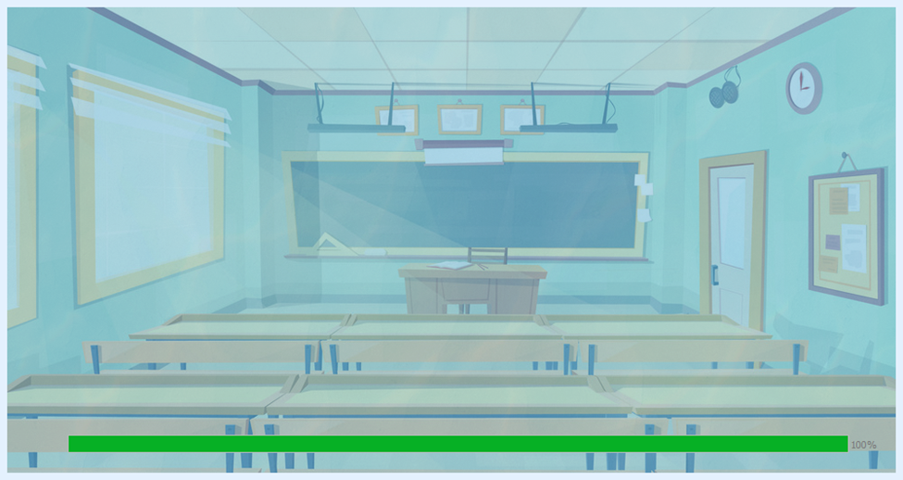
Splash Screen with A progress bar: -
To the Right is a splash screen with a progress bar which will appear for a few Seconds and then disappears before the Main Screen Appears

Slide 4
Code that displays the splash screen
splash_pix = QPixmap(":/newPrefix/splashSreenFinal.png")
splash = QSplashScreen(splash_pix, Qt.WindowStaysOnTopHint)
splash.setWindowFlags(Qt.WindowStaysOnTopHint | Qt.FramelessWindowHint)
splash.setEnabled(False)
progressBar = QProgressBar(splash)
progressBar.setMaximum(10)
progressBar.setGeometry(75, splash_pix.height() - 50, 900, 20)
# splash.setMask(splash_pix.mask())
splash.show()
for i in range(1, 12):
progressBar.setValue(i)
t = time.time()
while time.time() < t + 0.1:
app.processEvents()
# Simulate something that takes time
time.sleep(1)

Slide 5
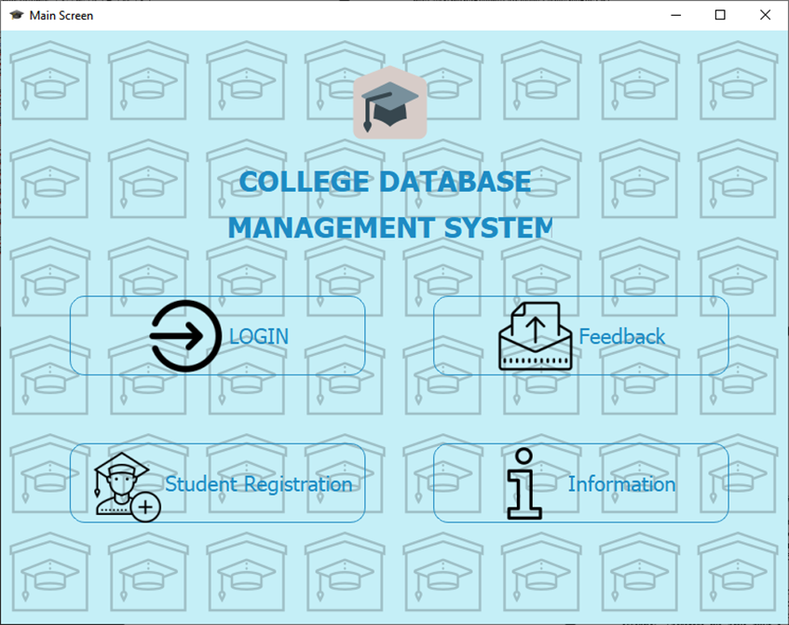
Main Screen :-
The Main Screen Opens After the Splash Screen
The Following are the Buttons on the Screen:-
Login Button
Student Registration
Feedback
Information

Slide 6
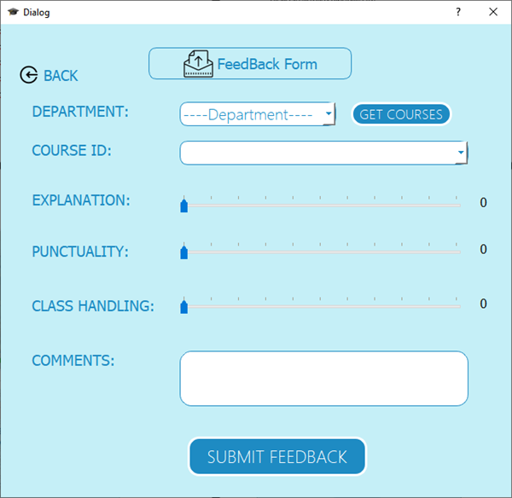
Feedback Screen:
If any user has to give feedback, they can do so by clicking on the Feedback screen on the main screen, after which they will be directed to this page

Slide 7
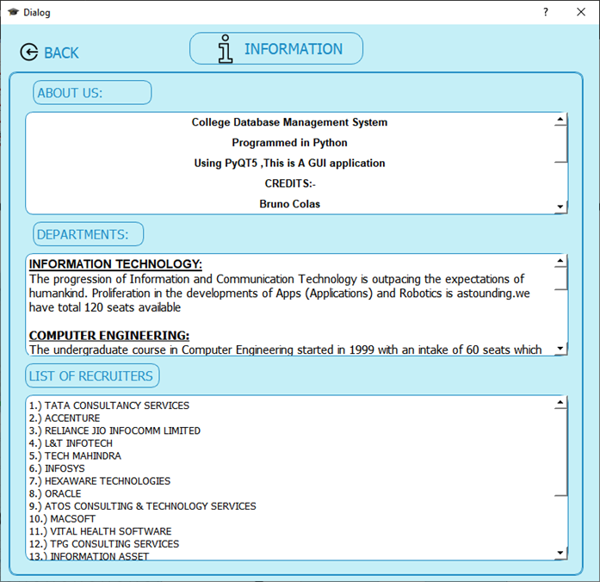
Information Screen:
To the Right is the information screen. Information related to the organization will be displayed here. Information like the various departments and information related to this department and detailed list of Recruiters and creators of the application.

Slide 8
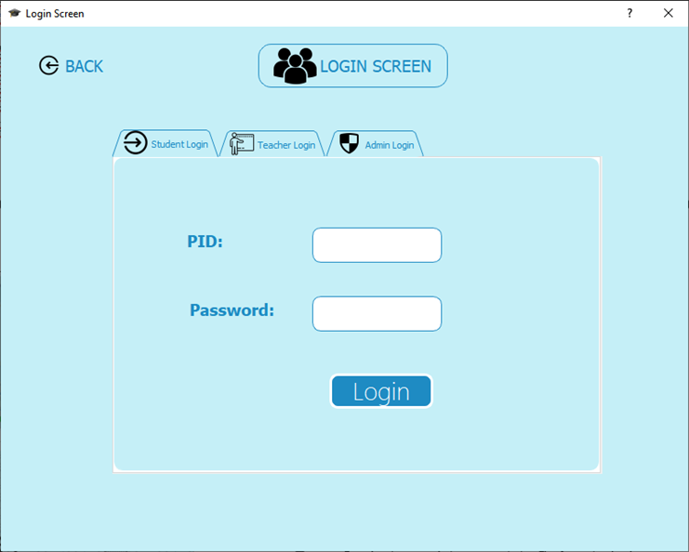
Login Screen:-
The Login Screen has three different Sections
Student Login
Teacher Login
Admin Login

Slide 9
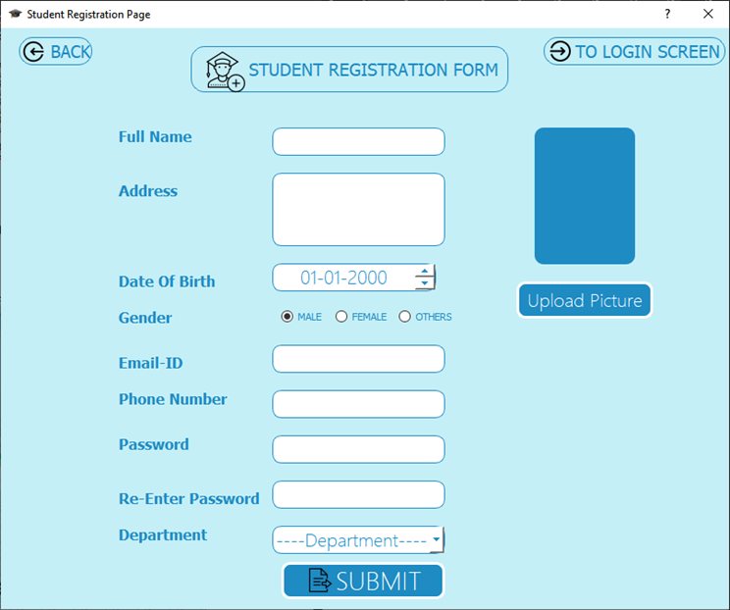
Student Registration Screen:
To the right is the student registration screen. If a new student user wants to register than by clicking the Student Registration button the above registration screen will appear where in the user must enter their details
Email-ID Must Be an original Email-Id as a Verification Code will be sent to his/her email-id.
Student PID and Password Will also be sent on the Email-ID after Registration is complete

Slide 10
Post-Student Registration
def loginfun(self): username=self.PIDstudent.text() password=self.PasswordStudent.text() if len(username)==6: if password: host="localhost";user="root"; dbname="studentDBMS" conn = pymysql.connect(host, user=user,port=3306,passwd="reuben", db=dbname) cursor=conn.cursor() loginStudent="SELECT * from student_registration where PID=%s and passwd=%s" dat=cursor.execute(loginStudent,(username,password)) # executing the cursor2=conn.cursor() queryToApproval="SELECT Approval from student_registration where PID=%s and passwd=%s" cursor2.execute(queryToApproval,(username,password)) Appro_Student=cursor2.fetchall() if (len(cursor.fetchall())>0): if Appro_Student[0][0]!="NOT APPROVED": self.messagebox("Successful","You Have Successfully Logined") self.adminwin=QtWidgets.QDialog() self.ui=Ui_StudentScreen(username,password) self.ui.setupUi(self.adminwin) self.adminwin.show() else: self.warning("NOT APPROVED","YOUR DETAILS FOR APPROVAL ARE PENDING") else: self.warning("Incorrect Details","Incorrect PID or Password") conn.commit() # commiting the connection then closing it. conn.close() # closing the connection of the database else: self.warning("Password","Password Not Entered") else: self.warning("Incorrect PID","PID is A 6-digit Number")
If a new student who has registered tries to sign into his student account.
A message will be shown that his details haven’t been Approved
Only After the Student’s Details have been approved by the admin.
He will Not be able to Sign In.

Slide 11
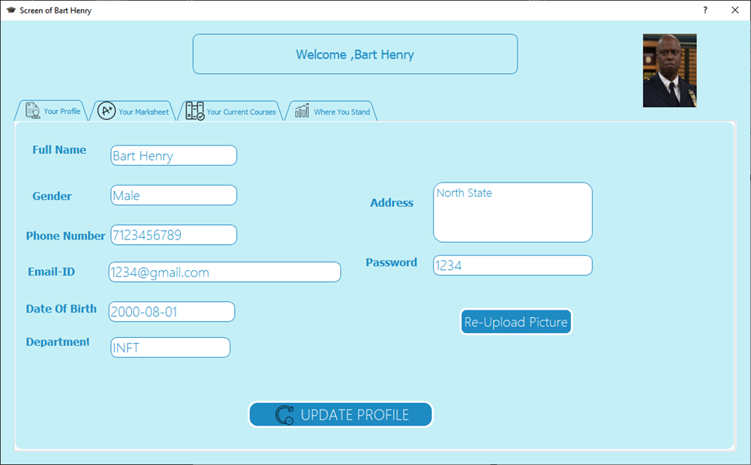
Student Screen After Sign In:
This screen appears after student has successful logged in. Here all the detail information of the student will be displayed. The Student can update his details and his picture.

Slide 12


Function to gets data from the database
def GetData(self,pid):
_translate = QtCore.QCoreApplication.translate
PID=pid
host="localhost"
port=3306;dbname="studentDBMS";user="root";password1="reuben"
conn = pymysql.connect(host, user=user,port=port,passwd=password1, db=dbname)
cursor=conn.cursor()
QueryToGetData="SELECT * FROM studentDBMS.student_registration where pid=%s"
cursor.execute(QueryToGetData,PID)
records=cursor.fetchall()
print(records)
self.fullnameLine.setText(_translate("Dialog",f"{records[0][1]}"))
self.email_idline.setText(_translate("Dialog",f"{records[0][7]}"))
self.dateofBirth.setText(_translate("Dialog",f"{records[0][4]}"))
self.GenderLine.setText(_translate("Dialog",f"{records[0][5]}"))
self.phone_numberline.setText(_translate("Dialog",f"{records[0][3]}"))
self.password.setText(_translate("Dialog",f"{records[0][6]}"))
self.departmentLine.setText(_translate("Dialog",f"{records[0][8]}"))
self.AddressLine.setText(_translate("Dialog",f"{records[0][2]}"))
try:
pixmap = QtGui.QPixmap()
pixmap.loadFromData(records[0][11])
self.ImageLabel_2.setPixmap(QtGui.QPixmap(pixmap))
except Exception as err:
pass
conn.commit()
conn.close()

Slide 13
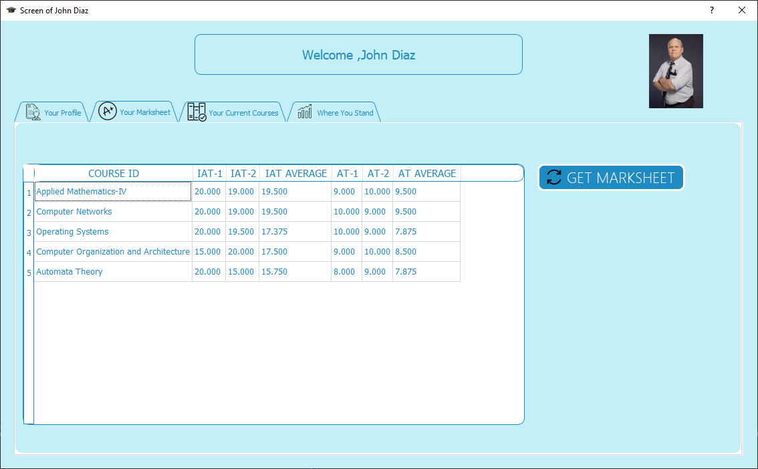
Student Marksheet:
Upon successful login, the authorized student can view their marksheet. Here all the marks obtained in various examination will be displayed here.

Slide 14
Function that Loads the Student Marksheet
def LoadIntoTableStudent(self):
host="localhost"
port=3306
dbname="studentDBMS"
user="root"
password1="reuben"
pass
conn = pymysql.connect(host, user=user,port=port,passwd=password1, db=dbname)
print("connection successful")
cursor=conn.cursor()
query = "SELECT distinct(crs.course_name), es.IAT_1, es.IAT_2, es.IAT_AVG, es.AT_1, es.AT_2, es.AT_AVG from exam_scheme es,course crs where PID=%s and crs.course_id=es.course_id;"
cursor.execute(query,(self.Student_PID))
result=cursor.fetchall()
self.Marksheet.setRowCount(0)
header=self.Marksheet.horizontalHeader()
header.setSectionResizeMode(QtWidgets.QHeaderView.ResizeToContents)
for row_no,row_data in enumerate(result):
self.Marksheet.insertRow(row_no)
for column_no,data in enumerate(row_data):
self.Marksheet.setItem(row_no,column_no,QtWidgets.QTableWidgetItem(str(data)))
self.Marksheet.setEditTriggers(QAbstractItemView.NoEditTriggers)

Slide 15
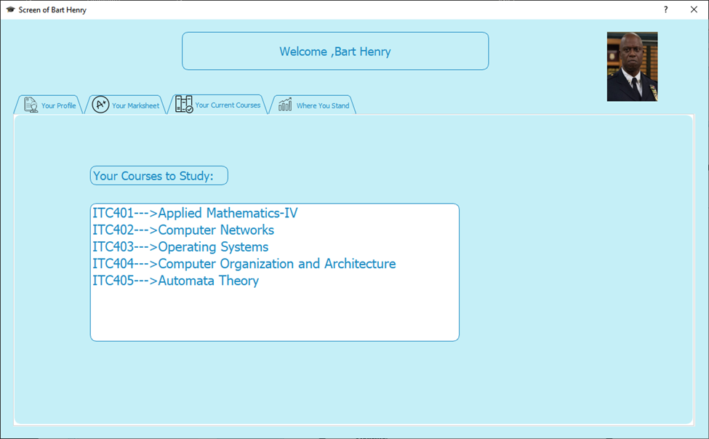
Student Course Alloted By Admin:
The above is the student‘s courses allotted by admin screen. Here the list of all the courses at has been allotted to the student by the admiin will be displayed here.

Slide 16
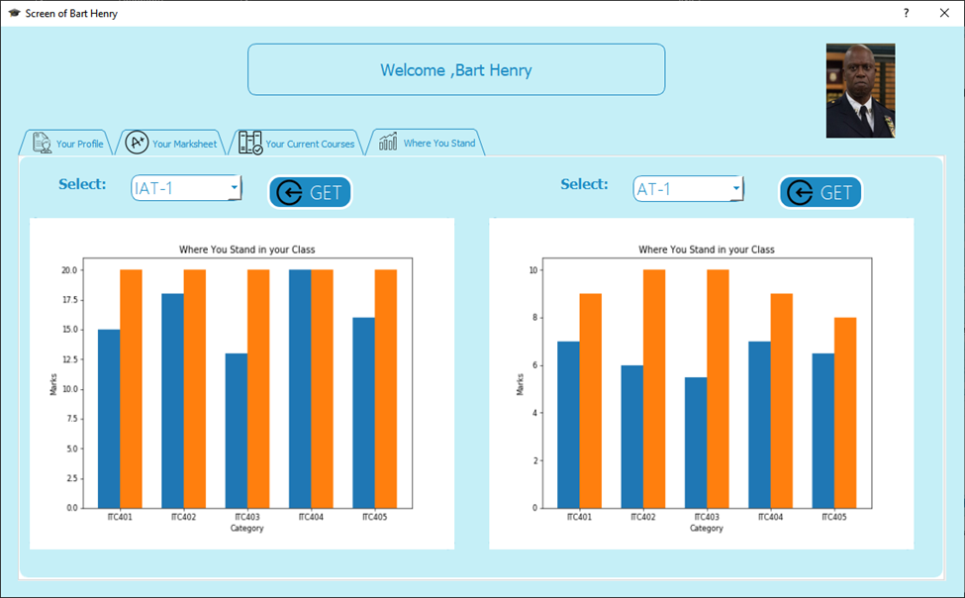
Comparison Of IAT Scores With Highest Marks:
The screen appears when the student wants to have a look of the marks obtained in graphical style. The plot is saved as image int he background and then the image that is saved is loaded in a label as graph.

Slide 17
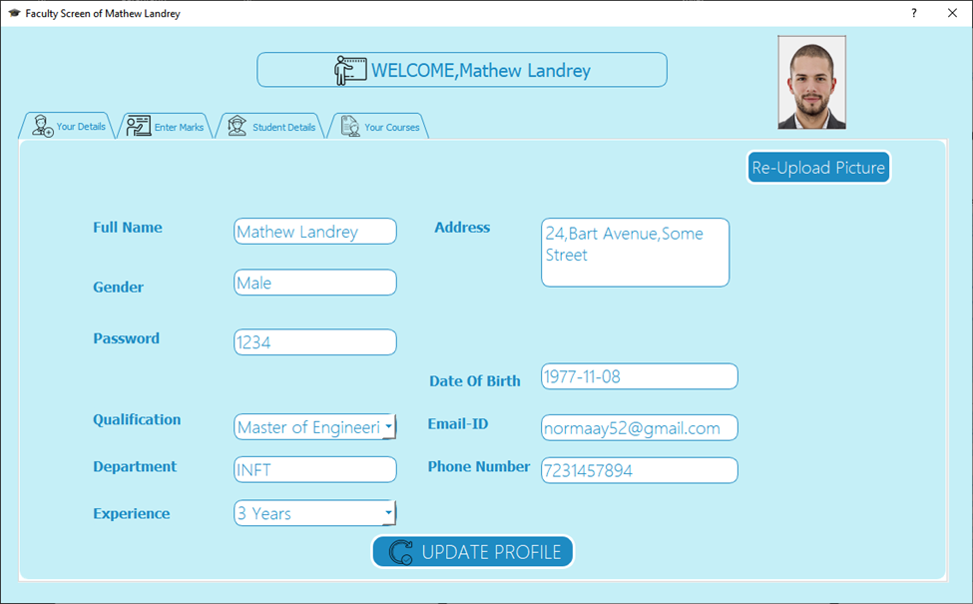
Teacher’s Screen After Sign In:
This is the screen that will appear after teacher’s successful login. Here all details of the teacher will be displayed.

Slide 18
Function that Updates the Teacher Details
def openImage(self):
global strimg
self.url=QFileDialog.getOpenFileName()
strimg=str(self.url[0])
self.ImageLabel.setPixmap(QtGui.QPixmap(strimg))
def convertToBinaryData(self,filename):
# Convert digital data to binary format
with open(filename, 'rb') as file:
binaryData = file.read()
return binaryData
def UpdateData(self):
global strimg
global urlofImage
PID=self.faculty_PID
passwordIn=self.passwordIn.text()
addressIn=self.AddressIn.toPlainText()
phNumberIn=self.phone_numberIn.text()
emailidIn=self.email_id_In.text()
experIn=self.Experi_In.currentText()
QualIn=self.Qualif_In.currentText()
now = datetime.now()
dt_string = now.strftime("%Y/%m/%d %H:%M:%S")
try:
host="localhost"
port=3306;dbname="studentDBMS";user="root";password1="reuben"
conn = pymysql.connect(host, user=user,port=port,passwd=password1, db=dbname)
cursor=conn.cursor()
QueryToGetData="SELECT profile_picture FROM studentDBMS.faculty where fac_id=%s"
cursor.execute(QueryToGetData,PID)
pp=cursor.fetchall()
print(pp[0][0])
urlofImage=pp[0][0]
urlofImage = self.convertToBinaryData(strimg)
except Exception as err:
self.warning("ERROR",f"{err} OR FACULTY DOESNT Exist")
updateargs=(addressIn,passwordIn,phNumberIn,emailidIn,experIn,QualIn,dt_string,urlofImage,PID)
QueryToGetData="UPDATE studentDBMS.faculty set address=%s,passwd=%s,phone_no=%s,email_id=%s,experience=%s,qualification=%s,login_date_time=%s,profile_picture=%s where fac_id=%s"
cursor.execute(QueryToGetData,updateargs)
conn.commit()
conn.close()
self.messagebox("Successfully Updated Data","Update Your Data Successful")

Slide 19
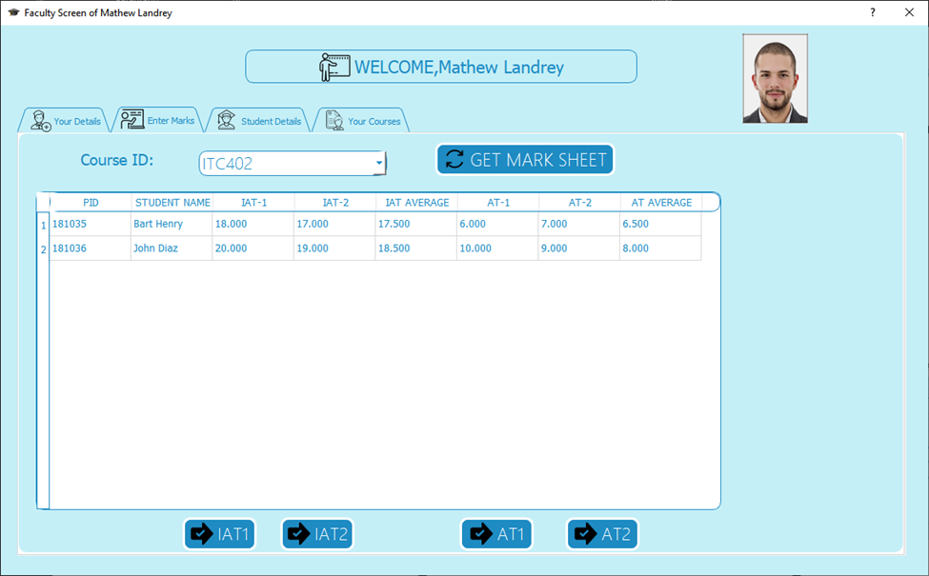
Teacher Entering Marks:
In the Screen Enter Marksheet Section the Faculty will first get a list of students who have taken that course and after than he/she can enter the marks for IAT-1 and click the IAT-1 Button after Entering. Later when the Faculty Adds in IAT-2 marks Clicks on the IAT-2 Button and after than the marksheet automatically displays the IAT AVERAGE, The Same follows for AT-1 and AT-2.

Slide 20
Function that Loads the students Marksheet for teacher to Enter Marks
def LoadIntoTableStudent(self):
courseID=self.Courses.currentText()
host="localhost"
port=3306
dbname="studentDBMS"
user="root"
password1="reuben"
pass
conn = pymysql.connect(host, user=user,port=port,passwd=password1, db=dbname)
print("connection successful")
cursor=conn.cursor()
query = "SELECT sr.PID, sr.full_name, es.IAT_1, es.IAT_2, es.IAT_AVG, es.AT_1, es.AT_2, es.AT_AVG FROM student_registration sr, exam_scheme es WHERE sr.PID = es.PID AND es.course_id =%s;"
cursor.execute(query,courseID)
result=cursor.fetchall()
self.Marksheet.setRowCount(0)
# header=self.tableWidget.horizontalHeader()
# header.setSectionResizeMode(QtWidgets.QHeaderView.ResizeToContents)
for row_no,row_data in enumerate(result):
self.Marksheet.insertRow(row_no)
for column_no,data in enumerate(row_data):
self.Marksheet.setItem(row_no,column_no,QtWidgets.QTableWidgetItem(str(data)))

Slide 21
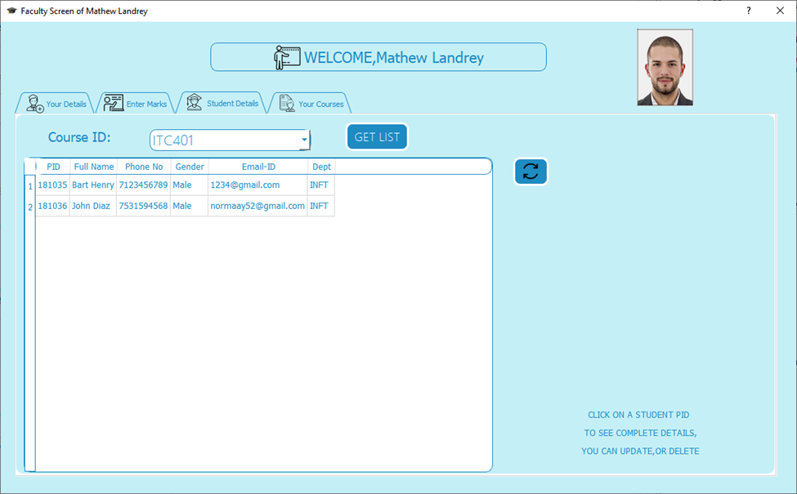
Student List In Teacher Screen:
The above Displays Only those Students which have been allotted the Course in the Student Details Table.

Slide 22
Function that Loads the Students Details of Students who have taken the course which the teacher is teaching
def LoadIntoStudentDetails(self):
courseID=self.Courses.currentText()
host="localhost"
port=3306
dbname="studentDBMS"
user="root"
password1="reuben"
pass
conn = pymysql.connect(host, user=user,port=port,passwd=password1, db=dbname)
print("connection successful")
cursor=conn.cursor()
query = "SELECT distinct(sr.PID), sr.full_name, sr.phone_no, sr.gender, sr.email_id, sr.id_dept FROM student_registration sr,takes tk,course crs WHERE sr.id_dept=crs.dept_id and tk.course_id=%s and sr.id_dept=%s;"
cursor.execute(query,(courseID,self.faculty_department))
result=cursor.fetchall()
self.studentDetails.setRowCount(0)
header=self.studentDetails.horizontalHeader()
header.setSectionResizeMode(QtWidgets.QHeaderView.ResizeToContents)
for row_no,row_data in enumerate(result):
self.studentDetails.insertRow(row_no)
for column_no,data in enumerate(row_data):
self.studentDetails.setItem(row_no,column_no,QtWidgets.QTableWidgetItem(str(data)))

Slide 23
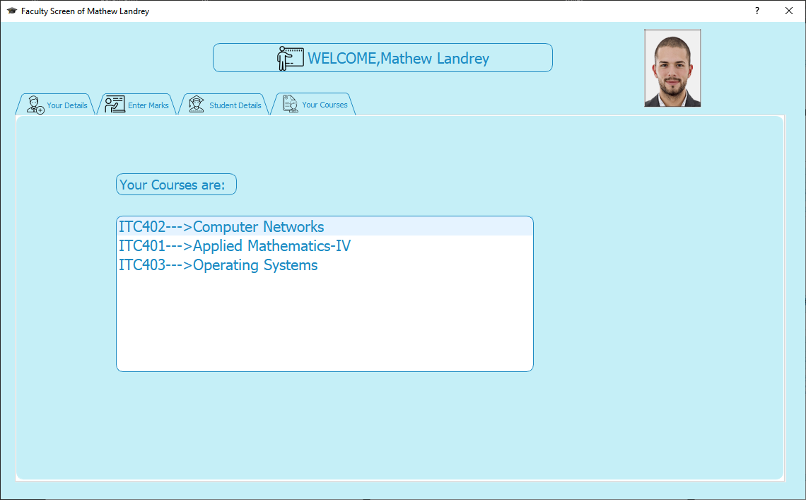
Courses' Tab in Teachers Screen
The Above Your Courses Tab Displays Only Those Courses which the admin has assigned the Respective faculty, the courses which the Faculty will teach.

Slide 24
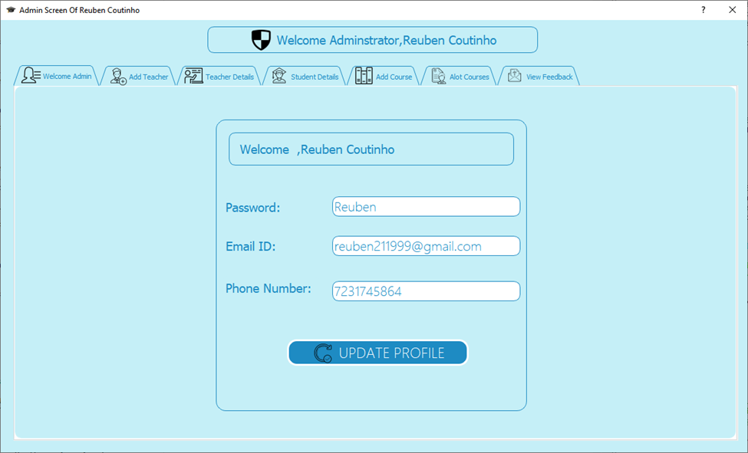
Admin Screen After Sign In:
There is no registration for Admin ,the admin details are straightaway added into the database.
The above is the Welcome Admin Tab where the admin details are preloaded into the Admin Screen as the admin signs in.
The admin can update his password,email-id and phone number.

Slide 25
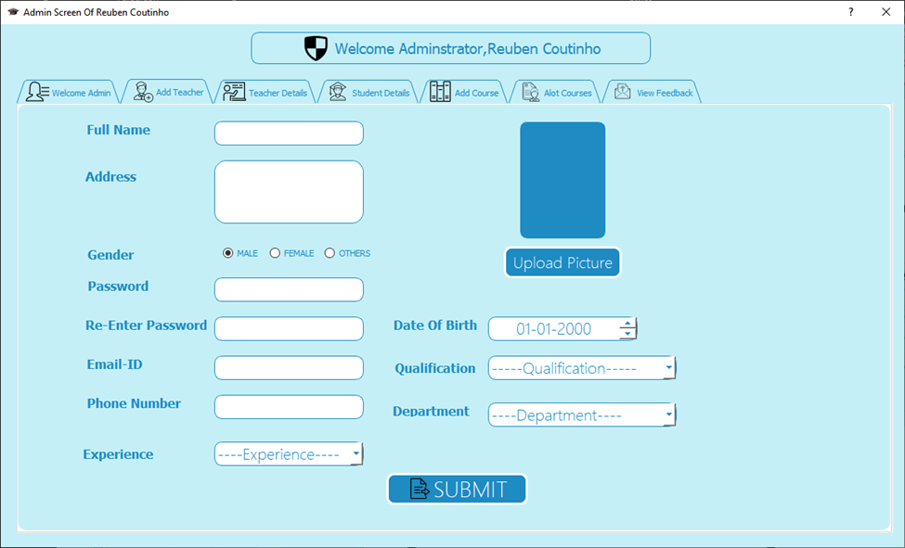
Add Teacher Screen:
The Add Teacher Tab is used to register the teacher into the database
After the Submit Button is clicked the Data is inserted into the faculty table
The Email-ID Entered here must be a Real Email-Id and not a dummy as the Faculty ID and Password will be sent to that Email-ID.

Slide 26
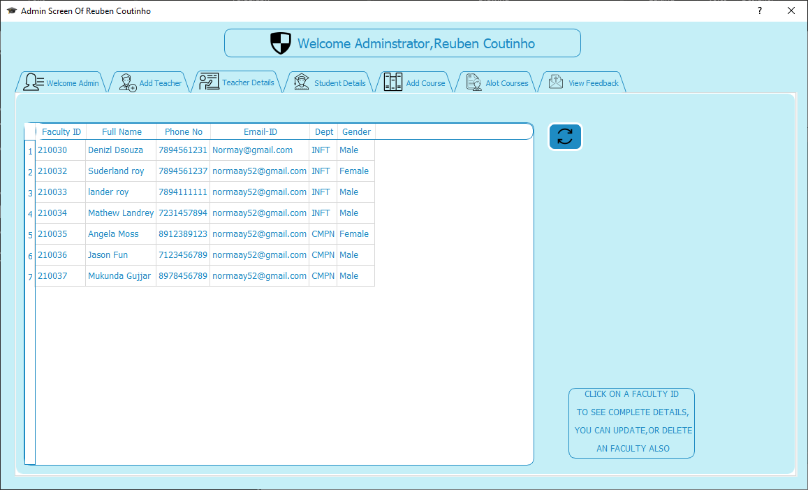
Teachers Detail In Admin Screen:
The Teacher Details tab shows Teachers Details, and the refresh button is there to see if there are any new entries.

Slide 27
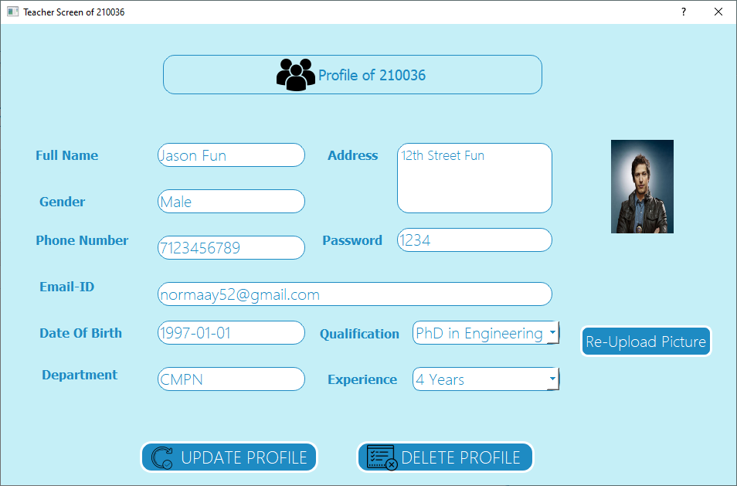
After clicking on a Faculty Id:-
Screen Appears when the we click on a Faculty ID from the Faculty details Table in the Admin Screen. We can update the Faculty Profile.
We can also delete the same Faculty Profile

Slide 28
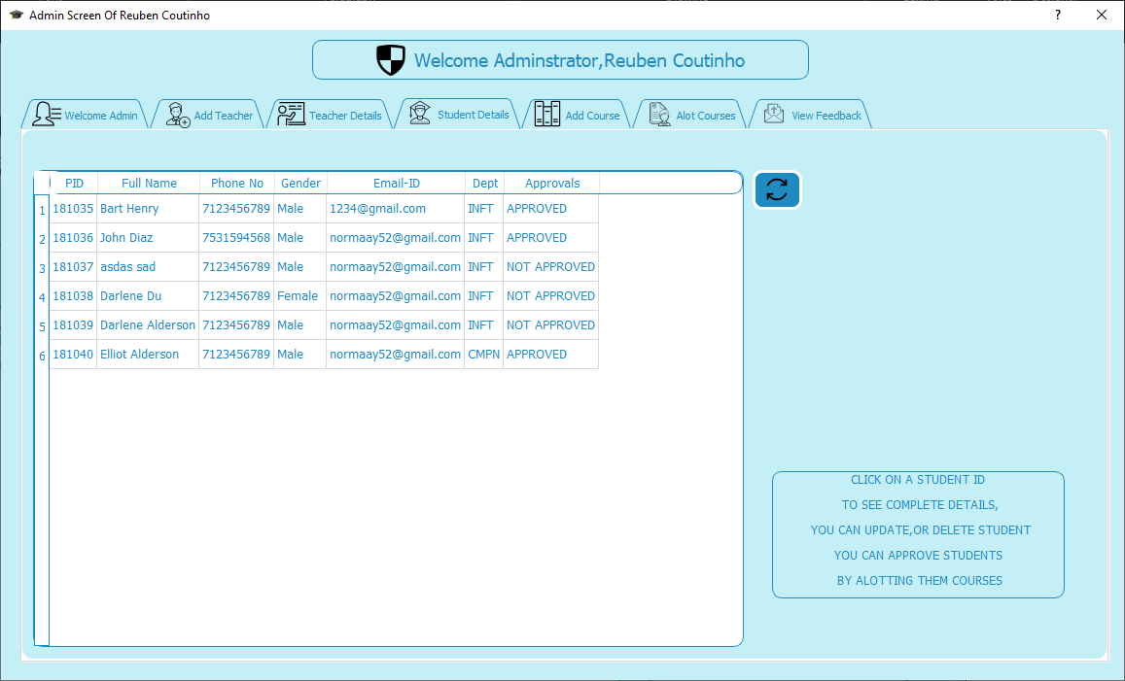
Student Details In Admin Screen:
The “Student Details” tab shows Student Details and the refresh button is there to see if there are any new entries.

Slide 29
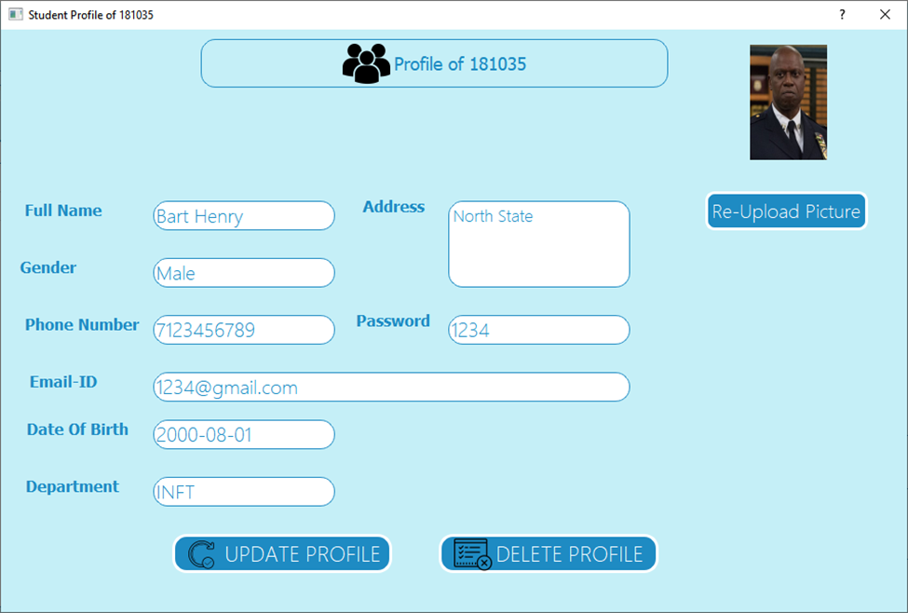
After Clicking On Student ID :
The Above Screen Appears when the we click on a student PID from the student details Table in the Admin Screen. We can update the Student Profile.
We can also delete the same Student Profile

Slide 30
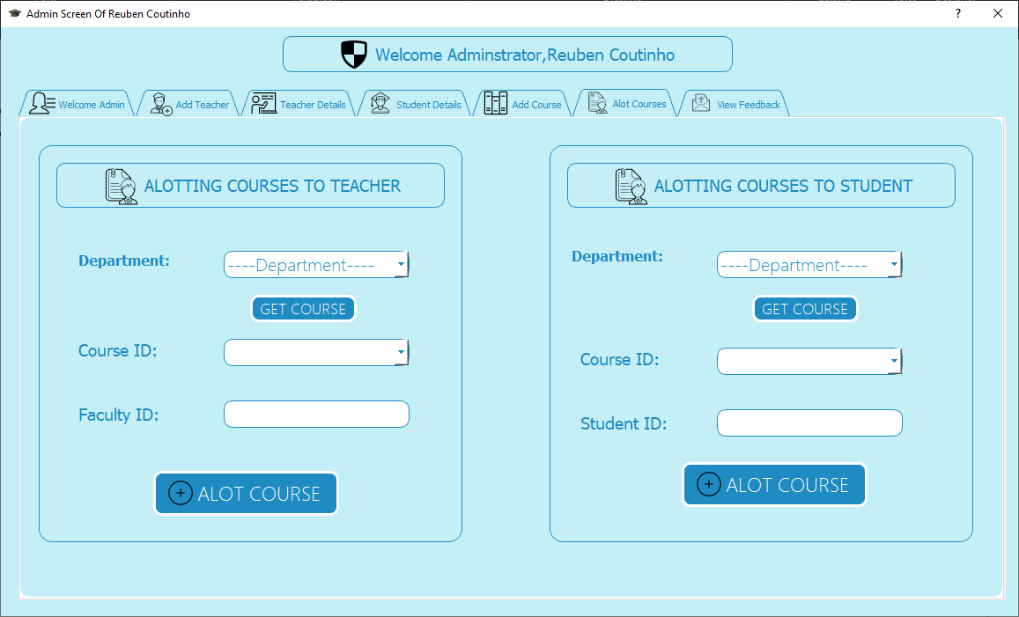
Admin Allotting Courses to Student & Teacher:
We have two Sections One Section in which Courses will be allotted to a teacher And Courses will be allotted to a Student.
After choosing A department from the Combo Box and the clicking Get Course, Only Those Courses Will Be available in the Courses Combo Box,
After that the admin will Enter The ID of Faculty in the faculty line edit or student ID in the Student Line Edit and
Just Incase If you try to allot the same course again to the same ID, an error will be thrown saying Same Courses can not be allotted.

Slide 31
Function to add course to teacher
def alotcourseT(self):
courseId=self.course_id_In.currentText()
idFaculty=self.faculty_ID_IN.text()
dept=self.dept_2.currentText()
# print(idFaculty,courseId,dept)
global host,port,dbname,user,passwordDataBase
connIds = pymysql.connect(host, user=user,port=port,passwd=passwordDataBase, db=dbname)
cursor2=connIds.cursor()
qyeryToGetIds="SELECT fac_id FROM studentdbms.faculty;"
cursor2.execute(qyeryToGetIds)
facultyIDs=cursor2.fetchall()
fac_ID=[]
for fi in range(len(facultyIDs)):
fac_ID.append(facultyIDs[fi][0])
# print(fac_ID)
connIds.commit()
connIds.close()
if courseId and idFaculty:
if courseId!="----Course-ID----":
if dept!="----Department----":
if int(idFaculty) in fac_ID:
args=(int(idFaculty),courseId[0:6])
conn1 = pymysql.connect(host, user=user,port=port,passwd=passwordDataBase, db=dbname)
cursor1=conn1.cursor()
query5 = "SELECT fac_id,course_id FROM studentdbms.teaches;"
cursor1.execute(query5)
gettingAllotedCourses=cursor1.fetchall()
conn1.commit()
conn1.close()
if args in gettingAllotedCourses:
self.warning("Same Course Alotted","You Can Not Allot Same Courses Again")
else:
pass
try:
conn = pymysql.connect(host, user=user,port=port,passwd=passwordDataBase, db=dbname)
cursor=conn.cursor()
queyCourses="INSERT into studentDBMS.teaches (fac_id,course_id) VALUES (%s,%s)"
cursor.execute(queyCourses,args)
conn.commit()
conn.close()
self.messagebox("Successful Alotted","Course Alotted Successfully")
except pymysql.Error as error:
self.warning("ERROR INSERTING",f"{error} OR U havent Added the course Yet")
else:
self.warning("Faculty ID Error","Faculty ID Entered is Incorrect")
else:
self.warning("Department Error","Department Selected is Incorrect")
else:
self.warning("Course-ID Error","Course-ID Selected is Incorrect")
else:
self.warning("Error ","No Faculty ID Entered")

Slide 32
Function to add course to Student
def alotcourseS(self):
courseId=self.course_id_In_Student.currentText()
idStudent=self.faculty_ID_IN_Student.text()
dept=self.dept_3.currentText()
# print(idStudent,courseId,dept)
global host,port,dbname,user,passwordDataBase
connIds = pymysql.connect(host, user=user,port=port,passwd=passwordDataBase, db=dbname)
cursor2=connIds.cursor()
qyeryToGetIds="SELECT PID,id_dept FROM studentdbms.student_registration;"
cursor2.execute(qyeryToGetIds)
facultyIDs=cursor2.fetchall()
Stud_ID=[]
for fi in range(len(facultyIDs)):
Stud_ID.append(facultyIDs[fi][0])
cursorForIddeptcheck=connIds.cursor()
QueryToConfirmID="SELECT id_dept FROM studentdbms.student_registration where PID=%s;"
cursorForIddeptcheck.execute(QueryToConfirmID,(int(idStudent)))
dept_check_student=cursorForIddeptcheck.fetchall()
print(dept_check_student)
connIds.commit()
connIds.close()
approvalApproved="APPROVED"
if courseId and idStudent:
if courseId!="----Course-ID----":
if dept!="----Department----":
if dept==str(dept_check_student[0][0]):
if int(idStudent) in Stud_ID:
if courseId=="--ALL COURSES--":
try:
conn1A = pymysql.connect(host, user=user,port=port,passwd=passwordDataBase, db=dbname)
cursorForapproval=conn1A.cursor()
UpdateAppro="UPDATE student_registration SET Approval=%s where pid=%s"
cursorForapproval.execute(UpdateAppro,(approvalApproved,int(idStudent)))
cursor1=conn1A.cursor()
query5 = "SELECT * FROM studentdbms.course where dept_id=%s;"
cursor1.execute(query5,str(dept))
gettingAllotedCourses=cursor1.fetchall()
conn1A.commit()
conn1A.close()
course_ID_List=[]
for record in range(len(gettingAllotedCourses)):
course_ID_List.append(gettingAllotedCourses[record][0])
# print(course_ID_List)
conn2B = pymysql.connect(host, user=user,port=port,passwd=passwordDataBase, db=dbname)
cursor2=conn2B.cursor()
queyCourses="SELECT PID,course_id From studentDBMS.takes "
cursor2.execute(queyCourses)
records569=cursor2.fetchall()
# print(records569)
conn2B.commit()
conn2B.close()
conn3B = pymysql.connect(host, user=user,port=port,passwd=passwordDataBase, db=dbname)
cursor2C=conn3B.cursor()
queyCourses="SELECT PID,course_id From studentDBMS.exam_scheme; "
cursor2C.execute(queyCourses)
recordOfExams=cursor2C.fetchall()
conn3B.commit()
conn3B.close()
for ins in range(len(course_ID_List)):
conn1 = pymysql.connect(host, user=user,port=port,passwd=passwordDataBase, db=dbname)
cursor1=conn1.cursor()
args=(int(idStudent),course_ID_List[ins])
if args not in records569:
queyCourses="INSERT into studentDBMS.takes (PID,course_id) VALUES (%s,%s)"
cursor1.execute(queyCourses,args)
cursor1.execute(query5,dept)
conn1.commit()
conn1.close()
print("s")
else:
pass
print("F")
if args not in recordOfExams:
conn12 = pymysql.connect(host, user=user,port=port,passwd=passwordDataBase, db=dbname)
cursorForExamScheme=conn12.cursor()
examquery="INSERT into studentDBMS.exam_scheme (PID,course_id) VALUES (%s,%s)"
cursorForExamScheme.execute(examquery,args)
conn12.commit()
conn12.close()
else:
pass
print("Exam alotted")
self.messagebox("ALL COUSES","ALL COURSES INSERTED OR HAVE ALREADY BEEN INSERTED")
except pymysql.Error as error:
self.warning("ERROR INSERTING",f"{error} OR U havent Added the course Yet")
elif courseId!="--ALL COURSES--":
args=(int(idStudent),courseId[0:6])
conn1 = pymysql.connect(host, user=user,port=port,passwd=passwordDataBase, db=dbname)
cursor1=conn1.cursor()
query5 = "SELECT PID,course_id FROM studentdbms.takes;"
cursor1.execute(query5)
gettingAllotedCourses=cursor1.fetchall()
conn1.commit()
conn1.close()
conn1A = pymysql.connect(host, user=user,port=port,passwd=passwordDataBase, db=dbname)
cursorForapproval=conn1A.cursor()
UpdateAppro="UPDATE student_registration SET Approval=%s where pid=%s"
cursorForapproval.execute(UpdateAppro,(approvalApproved,idStudent))
if args in gettingAllotedCourses:
self.warning("Same Course Alotted","You Can Not Allot Same Courses Again")
else:
pass
try:
conn = pymysql.connect(host, user=user,port=port,passwd=passwordDataBase1, db=dbname)
cursor=conn.cursor()
queyCourses="INSERT into studentDBMS.takes (PID,course_id) VALUES (%s,%s)"
cursor.execute(queyCourses,args)
conn.commit()
conn.close()
self.messagebox("Successful Alotted","Course Alotted Successfully")
except pymysql.Error as error:
self.warning("ERROR INSERTING",f"{error} OR U havent Added the course Yet")
else:
self.warning("Student ID Error","Student ID Entered is Incorrect")
else:
self.warning("Student Error","Student Not From Same Department")
else:
self.warning("Department Error","Department Selected is Incorrect")
else:
self.warning("Course-ID Error","Course-ID Selected is Incorrect")
else:
self.warning("Error ","No Student ID Entered")

Slide 33
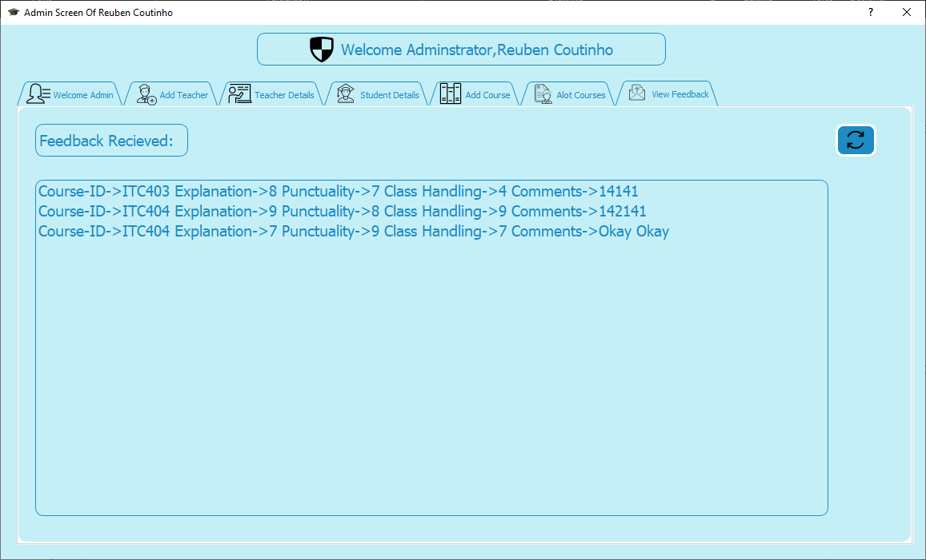
Admin Viewing Feedback given as per course:-
In the Screenshot when the Admin see his “View Feedback” Tab where the feedback from the database is already loaded into the List View and a refresh button to refresh and get back values from the database again

Slide 34
Function to that load the Feedback
def GetCoursesListFeeback(self,Fullname=None):
print(Fullname)
global host,port,dbname,user,passwordDataBase
pass
self.listWidget.clear()
conn = pymysql.connect(host, user=user,port=port,passwd=passwordDataBase, db=dbname)
# print("connection successful")
Query="SELECT course_id, explainantion, Punctuality, Class_Handling, Comments From studentdbms.Feedback;"
cursor=conn.cursor()
cursor.execute(Query)
records=cursor.fetchall()
CourseFeeb=[]
for i in range(len(records)):
CourseFeeb.append(f"Course-ID->{records[i][0]} Explanation->{records[i][1]} Punctuality->{records[i][2]} Class Handling->{records[i][3]} Comments->{records[i][4]}")
# print(CourseFeeb)
self.listWidget.addItems(CourseFeeb)
conn.commit()
conn.close()

Slide 35
Conclusion
By performing this mini project experiment, we learned applications of various python concepts.
Data plays important role in every organization.
Therefore storing that data, retrieving that data and presenting this data in uncomplicated fashion is essential.
Therefore we have built a database management system for college organization.
From this experiment we also gain knowledge about presenting data in graphical style.
To sum up we got a grasp of various python concepts.

Slide 36
Thank You.

